Slide 1


Department of Computer Science and Engineering
THIRD EYE FOR VISUALLY IMPAIRED
SHAFREEN FATHIMA ASMATHULLAH KHAN [211419104241]
SHIRLY N [211419104250]
SUJITHRA [211419104272]
GUIDE:
Dr.T.TAMILVIZHI M.Tech,Phd
COORDINATOR:
Dr.K.VALARMATHI M.E,Phd

Slide 2
Introduction
People with visual impairments face many challenges in their daily lives, including difficulties with mobility, communication, and accessing information.
It is one of the most severe and life-changing disabilities that a person can face, and it impacts every aspect of their life, from their daily routines to their ability to work and socialize.

Slide 3
Objective of the Project
We propose a camera-based detection system that utilizes artificial intelligence (AI) to assist visually impaired individuals.
The system, which we call "Third Eye," employs AI algorithms for face recognition, Text recognition and speech synthesis.
The System is designed to provide Audio Feedback to users when it detects trained people, texts or signs in the user’s surroundings.

Slide 4
Literature Survey
YEAR | TITLE | AUTHOR | DESCRIPTION | ADVANTAGES | DISADVANTAGES
2023 | “Smart Assistive System for Blind People”. | Usman Masud. Tareq Saeeshunida , Mlaikhah | Our goal is to structure a modest, secure, wearable, and versatile framework for visually impaired to help them in their daily routines. | This proposal closely looks to solve everyday problems of a visually impaired person like identifying their acquaintance in the road or bus, capturing important moments of the day as pic or live, informing in case of emergency, and all such tasks can be solved by means of intelligent system to provide assistance as per situation mentioned. | It doesn’t make use of hybrid model for prediction in which the accuracy of the result may be more accurate.
2022 | "Analysis of Navigation Assistants for Blind and Visually Impaired People :A Systematic Review." | Sulaiman Khan, Shah Naziri, Habib Ullah Khan | The paper discusses the challenges in developing navigation and routing devices for blind and visually impaired people (BVIPs) and highlights the limitations of existing techniques such as e-cane or guide dog, infrared-based cane, and laser-based walker. | The advantages of this approach are that it provides a comprehensive analysis of the existing research and identifies areas for improvement in the development of navigation devices for visually impaired individuals. | A potential disadvantage is that the selection criteria for articles may limit the scope of the analysis.

Slide 5
Literature Survey
YEAR | TITLE | AUTHOR | DESCRIPTION | ADVANTAGES | DISADVANTAGES
2022 | “Wearable Navigation Assistant for Visually Impaired People". | Nasim Rand Hemanth Kumar | The "Smart Shoes" are designed to help visually impaired people move independently and safely. They are embedded with sensors, microcontrollers, buzzer, speaker, and vibration motor that alert the wearer about obstacles in front, wet floors, and water bodies. If the wearer falls down, an alert message is sent to their parent or caretaker's telegram bot. | They alert the wearer about obstacles, wet floors, and water bodies, increasing their safety and reducing the risk of accidents. The technology helps to provide a safe and comfortable companion in daily life activities. | The cost of the Smart Shoes may be high. The technology may not be fully reliable in detecting all obstacles or hazards.
2022 | "Obstacle Detection For Blind People Using Ultrasonic Sensors And Ardino Processor.” | Akbar Ali, Haroon Akbar, Zeeshan Sartaj | This project aims to provide a solution to enhance obstacle detection for visually impaired people using ultrasonic sound within the range of 3m to 4m. It utilizes an Arduino processor, ultrasonic sensors, buzzer, and connecting wires, which are all arranged on a cap for the person to wear. | This project provides a low-cost solution for obstacle detection that can be easily worn by visually impaired individuals. | This system is limited to obstacle detection only and does not provide information about the surrounding environment. The accuracy of the detection may also be affected by factors such as noise and interference.

Slide 6
Literature Survey
YEAR | TITLE | AUTHOR | DESCRIPTION | ADVANTAGES | DISADVANTAGES
2021 | “Mobile Based IoT Solution for Helping Visual Impairment Users”. | Hussein Abdel-Jaber, Hussein Albazar, Ahmed Abdel-Wahab, Malak El Amir,Areej Alqahtani, Mohammed Alobaid | The proposed solution is a smart stick with a mobile application to assist visually impaired people in navigating their surroundings. The stick is embedded with sensors that can detect obstacles, such as walls, tables, and vehicles, and the mobile application provides audio notifications to the user. If the user becomes lost, they can send an SMS with their GPS location. | The smart stick with mobile application can greatly improve the daily lives of visually impaired people by making many tasks simple, comfortable, and organized. The system can help them navigate their surroundings and avoid obstacles, increasing their safety and independence. | The system may have some limitations in terms of accuracy, as the sensors may not always detect all obstacles in the user's path. It also requires the use of a smartphone and a reliable internet connection
2021 | "Obstacle Detector for Blind Peoples" | M.Maragatharajan,G.Jegadeeshwaran,R.Askash,K.Aniruth,A. Sarath | The project uses an ultrasonic sensor to detect obstacles in front of visually impaired individuals within a certain range. When an obstacle is detected, a buzzer sound is produced to alert the user of its presence. | The project can help visually impaired individuals detect obstacles in their environment and navigate safely. | The system may not detect all obstacles in the environment, as it relies on the user being within a certain range of the ultrasonic sensor.

Slide 7
Problem Statement
The visually impaired people face many challenges in society and are often vulnerable to exploitation. They are heavily dependent on others for their day-to-day activities. Therefore, there is a need to empower them and provide them with a sense of independence. To address these challenges, we propose a camera-based detection system, which can be a game-changer for them. It enables them to read texts, recognize trained people, and detect signs through audio feedback, which increases their mobility and independence. This system also enhances their social interaction skills and reduces their dependence on others. this system has the great potential to improve the quality of life of visually impaired people.

Slide 8
Existing System
DRAWBACKS
The use of Braille language for reading documents is challenging for visually impaired individuals, leading to errors and incomplete reading.
The existing system's ultrasonic sensors have limited scope, making it difficult to detect objects outside of specific ranges and directions.

Slide 9
Proposed System
It provides greater independence and autonomy by allowing users to identify people, text and detect signs without the need for human supervision.
The system can be easily operated by visually impaired individuals with minimal training, and the Double Face Recognition feature enhances its usability.
It is more user-friendly and efficient as it eliminates the need for Braille reading and ultrasonic sensors.

Slide 10
Software / Hardware used
HARDWARE REQUIREMENTS
Processor : Intel i5
Hard disk : minimum 10 GB
RAM : minimum 4 GB
SOFTWARE REQUIREMENTS
Operating System : Windows 10 or later
Tool : Python IDLE

Slide 11
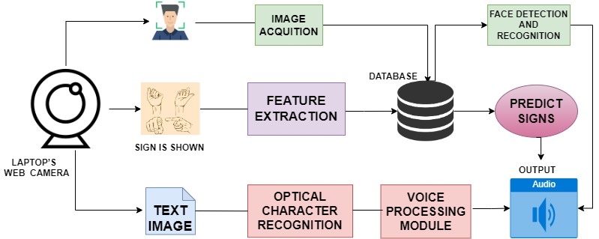
System Architecture

Slide 12
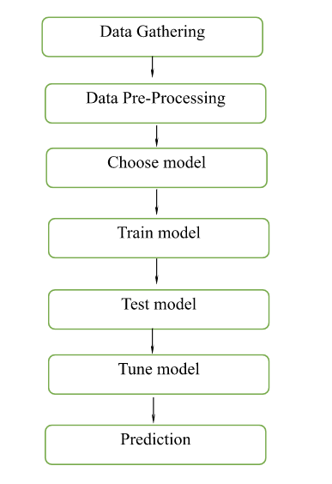
System Design - Flow Chart

Slide 13

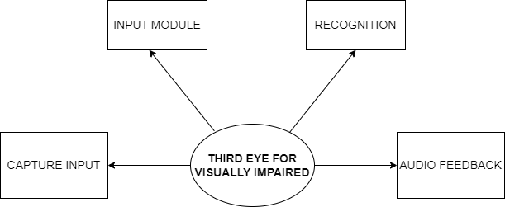
System Design –Data Flow Diagram
LEVEL 0
LEVEL 1

Slide 14
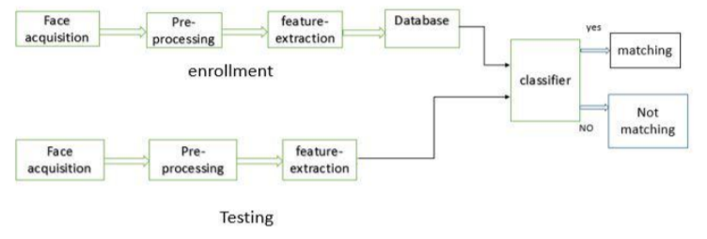
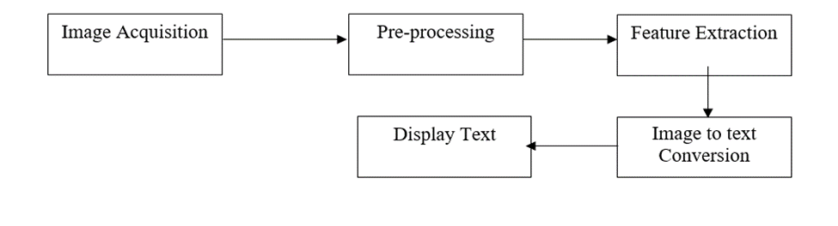
System Design – Entity Relationship Diagram
FACE RECOGNITION:
TEXT RECOGNITION:

Slide 15
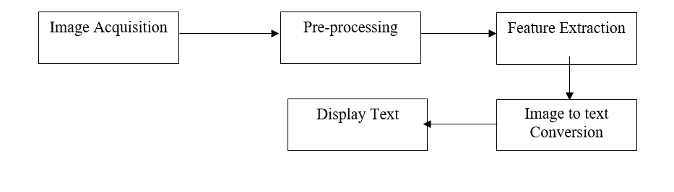
Entity Relationship Diagram(Contd.,)
SIGN PREDICTION:

Slide 16
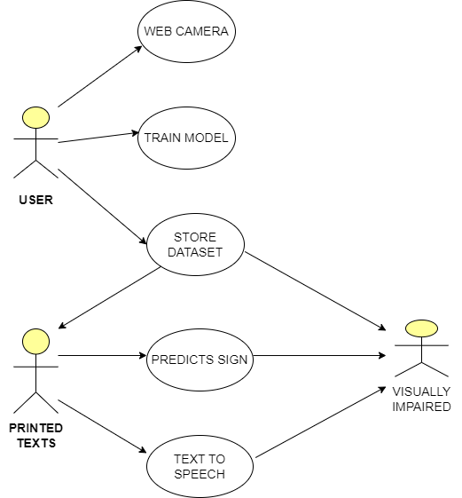
System Design – Use Case Diagram

Slide 17
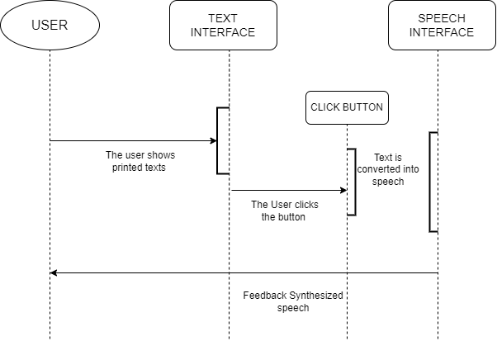
System Design – Sequence Diagram

Slide 18
Module Description
FACE RECOGNITION:
This module is responsible for processing the input image from the laptop’s web camera and recognize the face in the image.
Local Binary Pattern Histograms (LBPH) computes a binary pattern for each pixel in an image by comparing its value with its neighboring pixels.
The binary pattern is then used to represent the texture of the image. The algorithm uses a sliding window approach to compute the binary pattern for each pixel in the image.

Slide 19
Module Description(Contd..)
SIGN RECOGNITION
This module helps to create a tool that can recognize and translate sign language gestures into spoken language for individuals with hearing impairments.
The project will use computer vision and AI techniques to recognize the hand gestures and translate them into speech.
There are several APIs available to convert text to speech in Python.
One of such APIs is the Google Text to Speech API commonly known as the gTTS API. gTTS is a very easy to use tool which converts the text entered, into audio which can be saved as a mp3 file.

Slide 20
Module Description(Contd..)
TEXT RECOGNITION:
The input will be given through laptop’s web camera and Processes the input image using tesseract tool to recognize any text present in the image and returns the recognized text.
Python-tesseract is an optical character recognition (OCR) tool for python. That is, it will recognize and “read” the text embedded in images.
Python-tesseract is a wrapper for Google’s Tesseract-OCR Engine. It is also useful as a stand-alone invocation script to tesseract, as it can read all image types supported by the Pillow and Leptonica imaging libraries, including jpeg, png, gif, bmp, tiff, and others.

Slide 21
Module Description(Contd..)
AUDIO OUTPUT:
This module uses a text-to-speech (TTS) engine to convert the recognized name, text, or sign language phrase into an audible output.
The TTS engine receives the recognized input as a string and generates an audio output in the form of spoken words.
The audio output is then played through the laptop's speakers or headphones.

Slide 22
Testing and Results
TEST CASE ID | INPUT | EXPECTED OUTPUT | OBTAINED OUTPUT | PASS/FAIL | REMARKS
TC01 | Trained face | Name of the person | Name of the person | Pass | Prediction Successful
TC02 | Trained faces of two people | Names of both the person | Name of the person | Pass | Prediction Successful
TC03 | Text image | Reads the text aloud | Reads the text aloud | Pass | Prediction Successful
TC04 | Text from editor | Reads the text aloud | Reads the text aloud | Pass | Prediction Successful
TC05 | Printed texts | Reads the text aloud | Reads the text aloud | Pass | Prediction Successful
TC06 | Sign is shown | Provide voice output for shown gesture | Provide voice output for shown gesture | Pass | Prediction Successful

Slide 23
Screen Shots
USER INTERFACE

Slide 24
Screen Shots
FACE RECOGNITION

Slide 25
Screen Shots
TEXT RECOGNITION

Slide 26
Screen Shots
SIGN PREDICTION

Slide 27
Conclusion / Feature Enhancement
The Third Eye System is a significant advancement in assistive technology for visually impaired individuals. The system's ability to recognize faces, text, and sign language gestures provides valuable assistance to those with visual impairments, allowing them to navigate their surroundings with greater ease and independence. Our testing results have demonstrated the accuracy of the system's models, as well as the positive feedback from visually impaired individuals who
Have used this system.

Slide 28
Reference Paper
[1] Usman Masud, Tareq Saeed,Hunidam. Malaikah , Fezan Ul Islam, and Ghulam
Abbas,”Smart Assistive System for Visually Impaired People Obstruction Avoidance Through
Object Detection and Classification”, February 2022
https://drive.google.com/file/d/1vOawaLcxAIk4cx_TE7qtLFVkEm4AzuDO/view?usp=share
_link
[2] Sulaiman khan , Shah nazir, and Habib ullah khan ,” Analysis of Navigation Assistants for
Blind and Visually Impaired People:A Systematic Review”, February 2021
https://drive.google.com/file/d/1kexiHikfRO9CgvbBx5BZqklWsfcjwpn/view?usp=share_lin
k
[3] Chandan Debnath”Development of an Automated Obstacle Detector for Blind People”,
June 2019
https://drive.google.com/file/d/1L5WomLFYgLgsjXCus4vNqDRG95s5Ure/view?usp=share
[4] M. Maragatharajan, G. Jegadeeshwaran, R. Askash, K. Aniruth, A. Sarath, ” Obstacle Detector for Blind Peoples”, December 2019
https://drive.google.com/file/d/1ul9LNLjyFuHWT4xfFLDy2NmT4XoSzA/view?usp=share_link
[5] Akbar Ali, Haroon Akbar, Zeeshan Sartaj,” Obstacle Detection For Blind People Using Ultrasonic Sensors And Ardino Processor”, August 2022
https://drive.google.com/file/d/1Sd09Cs_UOAbL8twFvqETwkBlKw3D95GF/view?usp=share_link
[6] Moaiad Ahmad Khder, Malek Ali AlZaqebah, Ashraf Abazeed and Mohammad Adnan Saifi,“Smart Shoes for Visually Impaired/Blind People”, November 2018
https://drive.google.com/file/d/1Xm-56-VxprZMrPbFJs2KdSViifOuEvZ7/view?usp=share_link
[7] Roy Abi Zeid Daou, Jeffrey Chehade, Georgio Abou Haydar, Ali Hayek, Josef Boercsoek ,
“Design and Implementation of Smart Shoes for Blind and Visually Impaired People for More Secure Movements“, December 2020
https://drive.google.com/file/d/1LUobvZH_9NVSj05lCyZ88JKShXOlwEJB/view?usp=share_link
[8] Thanuja C S, Sahana M H, Sindhu G, Shruti B P,” Design of Smart Shoe for the Blind with Cordless Load”, December 2022
https://drive.google.com/file/d/1DDVXw9QzAaytO9w0h0NFXWpV1D1NIT3/view?usp=share_link

Slide 29
Reference Paper (Contd..)
[9] Shanthi. M, Madhu Meena. M. K, Kadiravan. R, Kowsalya. R. J, Lokharaj. N,” Li-Fi Based Smart Shoe for Blind”,2019
https://drive.google.com/file/d/1Nxu1GhV1CphgpNeklLIJTcQeGuwehQvF/view?usp=share_link
[10] Nidhi Malhotra ,” Smart Shoes for Blind Person”, October 2018
https://drive.google.com/file/d/1W4-w9jJk3vJ752kBKl_b8erZ8Q1-fp4U/view?usp=share_link
[11] Nasim R and Hemanth Kumar,” Smart Shoes: Wearable Navigation Assistant for Visually Impaired People”, June 2022
https://drive.google.com/file/d/1ljA4uOb3riXykzNzynWfrCT_O7V4a3CO/view?usp=share_link
[12] D.J.S.M. Prashnath, K. Bhargavi, G. SwathiI. Mahesh, P. Bheemeshwar,” Adiona - Smart Shoes For Blind”, July 2022
https://drive.google.com/file/d/1TyeTS9rNpI8dgbR5EvT36DJJevfwofqC/view?usp=share_link
[13] Ayat A. Nada, Mahmoud A. Fakhr, Ahmed F. Seddik ,” Assistive Infrared Sensor Based Smart Stick for Blind People”, July 2019
https://drive.google.com/file/d/1SI_hXynFzKfwle_yGjl8SUVvZmR05JRI/view?usp=share_link
[14] Hussein Abdel-Jaber, Hussein Albazar, Ahmed Abdel-Wahab, Malak El Amir, Areej Alqahtani, Mohammed Alobaid,” Mobile Based IoT Solution for Helping Visual Impairment Users”, August 2021
https://drive.google.com/file/d/1VD_5yiudUpFD9xLGzCLzVnc7tldFvI2h/view?usp=share_link
[15] Nazli Mohajeri, Roozbeh Raste, Sabalan Daneshvar,” An Obstacle Detection System for Blind People” , June 2018
https://drive.google.com/file/d/1J0C0L-0jtpne3ReSfo9KiFtdlX35Jmmd/view?usp=share_link

Slide 30
THANK YOU !!!

